Slide 1
Parents Meeting
Academic Year 2025 - 2026

Slide 2
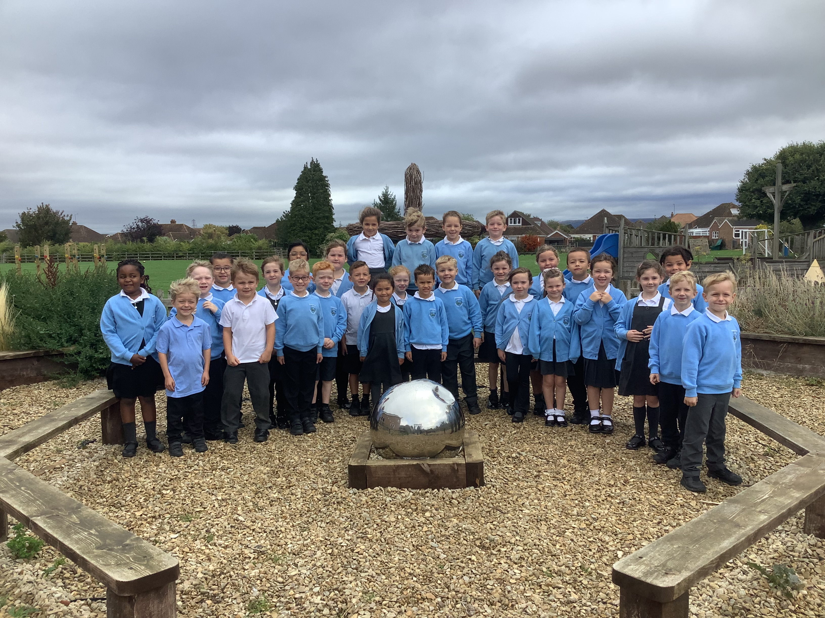
‘Love God and love your neighbour as you love yourself.’

Slide 3
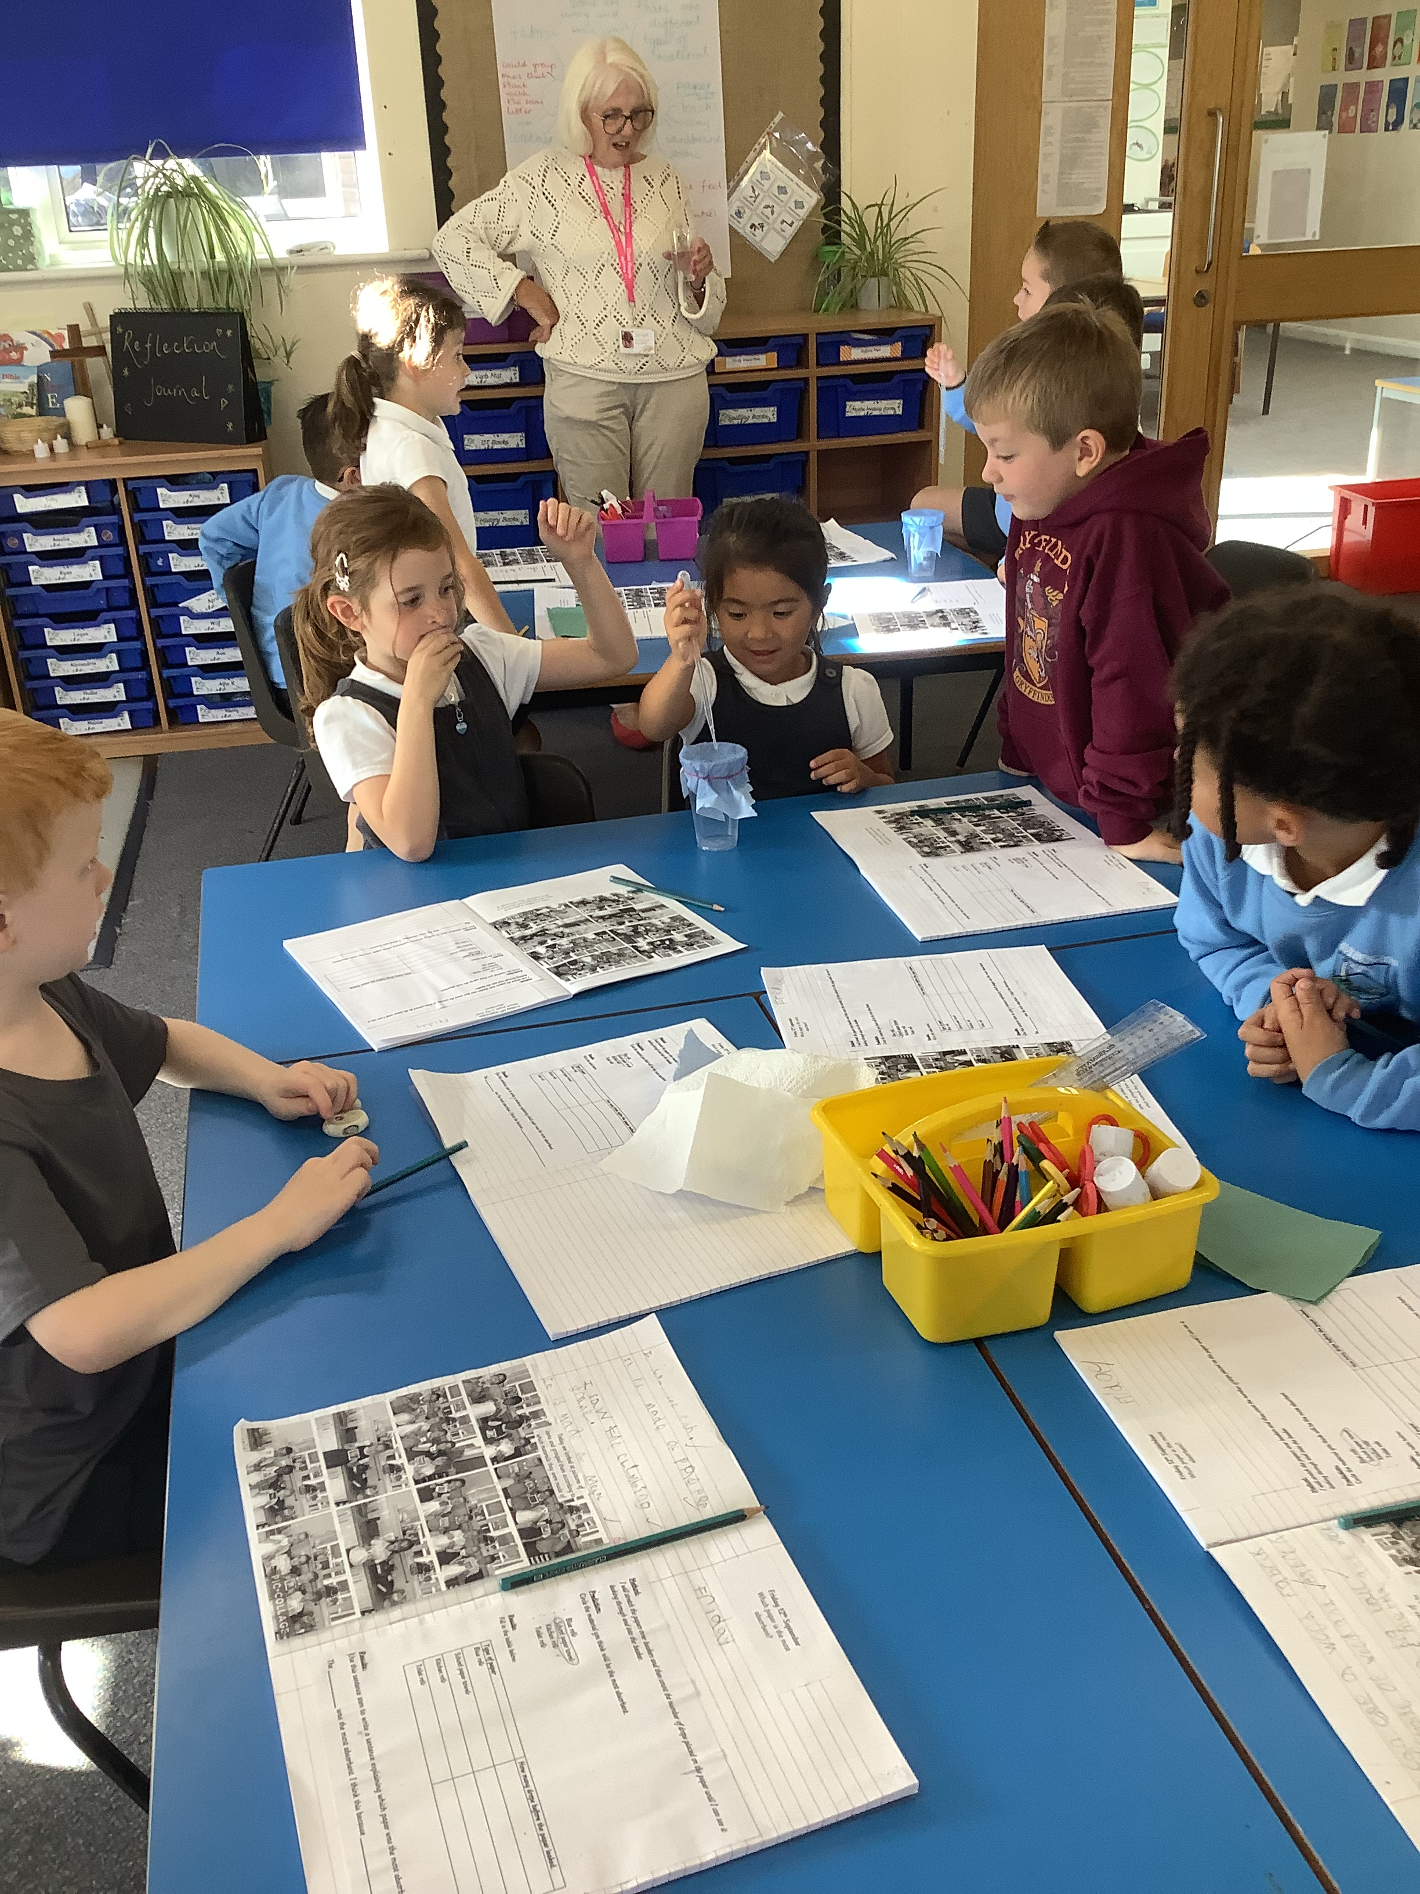
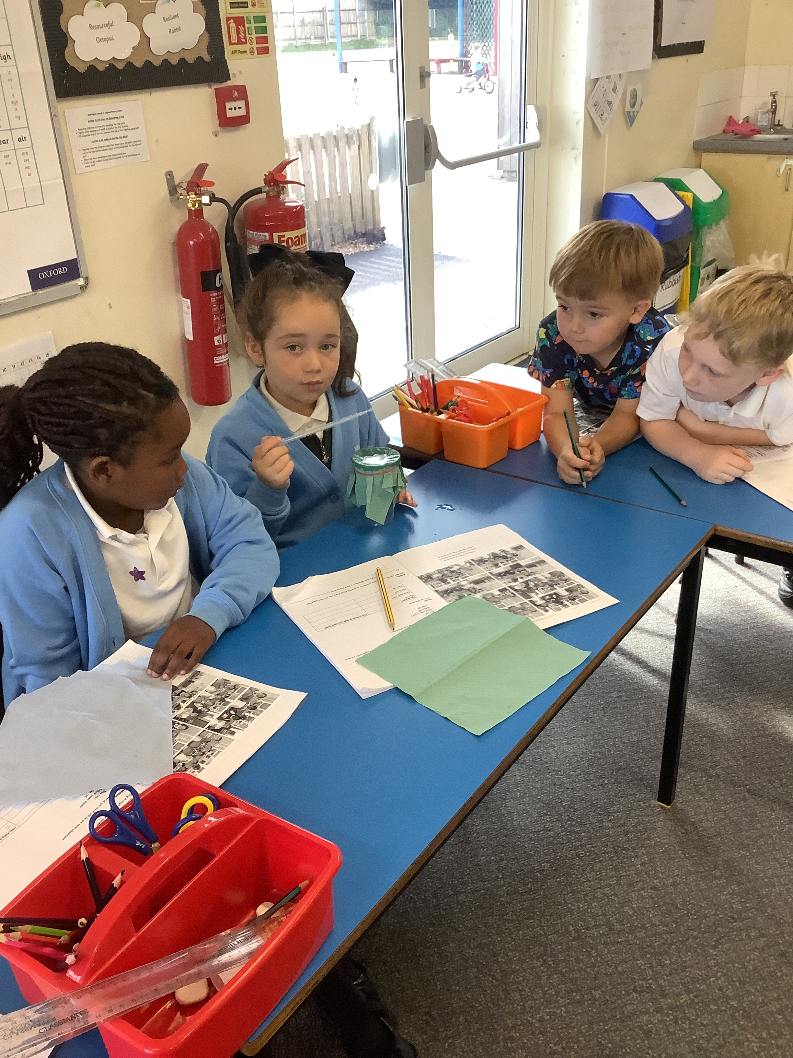
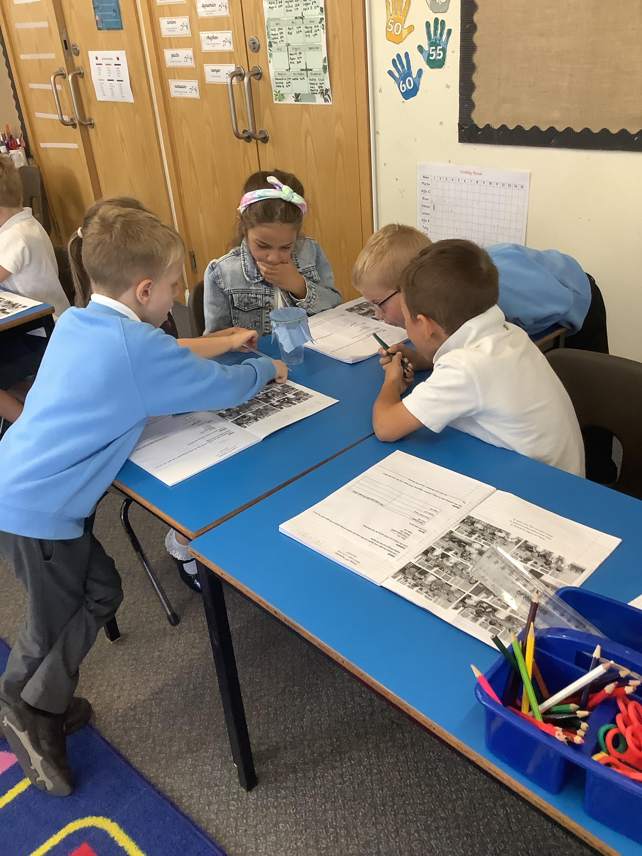
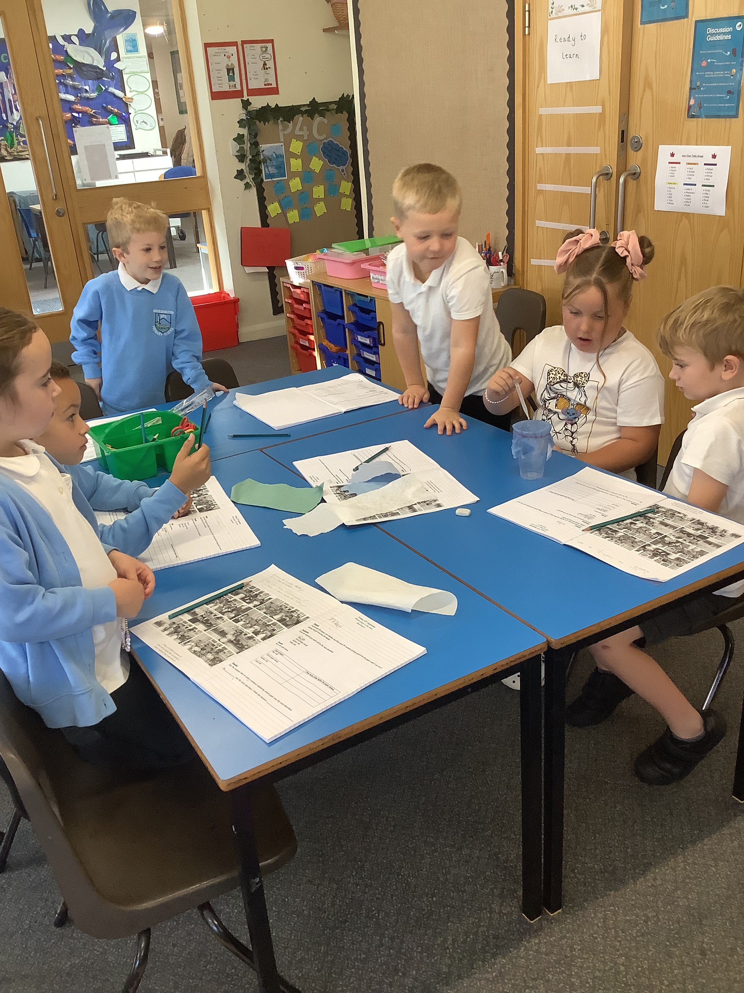
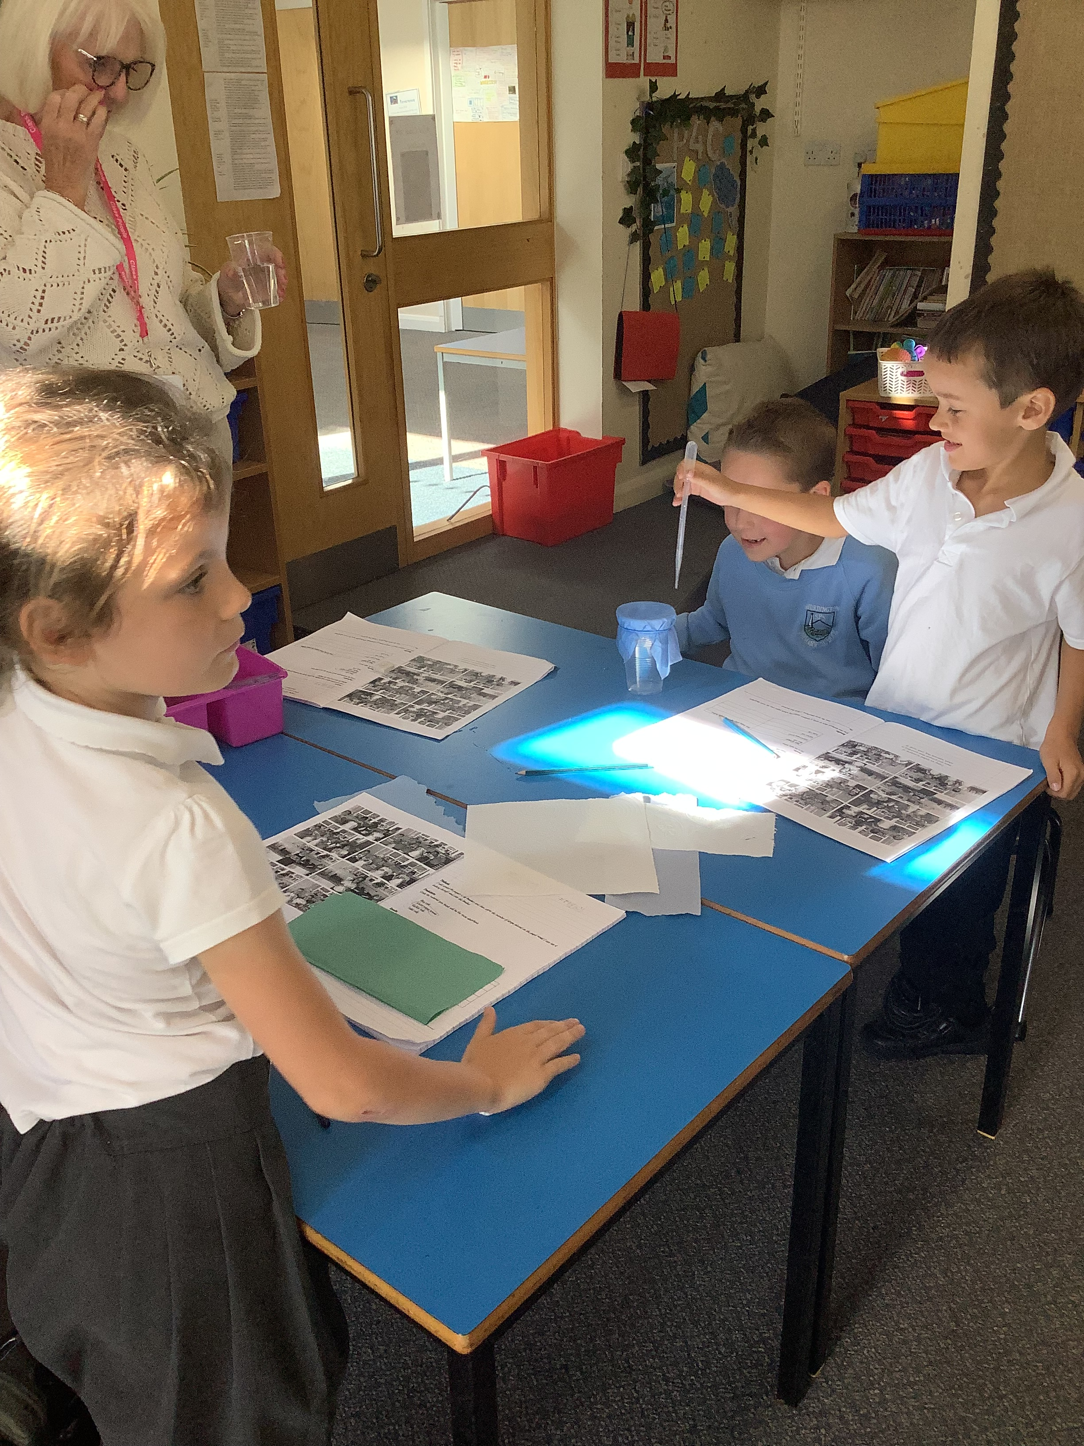
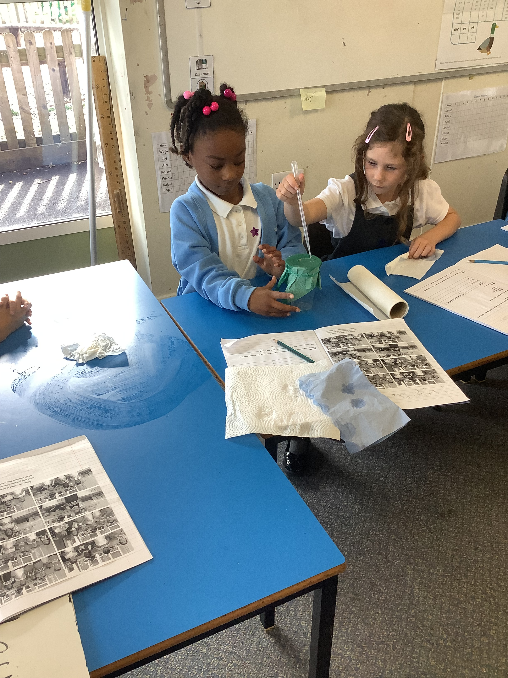
A great start !
I’ll

Slide 4
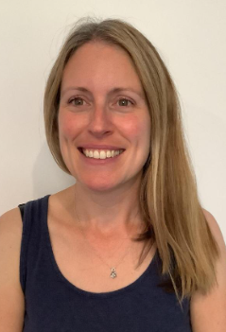
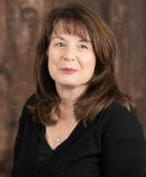
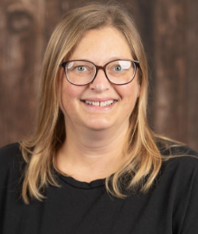
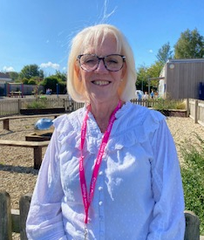
Adults in Class
Mrs. Rylatt- Monday & Tuesday .
Mrs. Murton – Wednesday ,Thursday and Friday
Teaching Assistant
Miss. Mason – Monday to Thursday fulltime. Mrs Capewell Friday .

Slide 5
Curriculum Overview
Daily Maths, English and Reading.
Spelling – three sessions a week.
Handwriting – two sessions a week.
Weekly R.E, Science and Geography or History.
There will be trips or enrichment visits and visitors throughout the year..

Slide 6
Timetable - am
Reading, English or maths task 8.40- 8.55
Register
Spellings
Shurdington Mile
Maths
Worship
Break
English
Guided reading

Slide 7
Timetable - pm
Register
Maths meeting
Curriculum
RE/History/Geography/Art/DT/Computing/PSHE/P4C
Class Novel
PE x2 each week

Slide 8
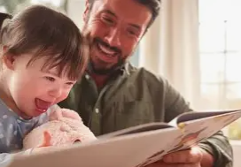




Reading, reading and more reading

Slide 9
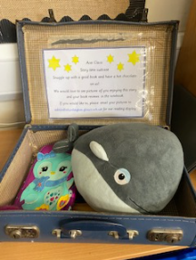
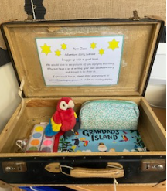
Reading suitcases

Slide 10
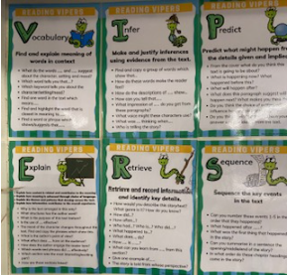
Guided reading

Slide 11
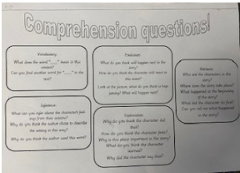
Comprehension is key

Slide 12

Class Novels

Slide 13
Homework – Friday to following Friday
English
Word boxes
Writing sentences
Maths
Maths activities and games
TT rock stars

Slide 14


Slide 15
Assessments
End of Key Stage 1 (optional for the school) Assessments in May.
BIG QUESTIONS
Any preparation will be in school as part of classwork. Children will take papers in Reading, Maths and GPS and independent writing tasks over the year.

Slide 16
Expectations
Be the BEST we can be!
Believe Enjoy Succeed Together
Behaviour will always be linked to our school rules.
Children becoming more independent P.E, resources, get the children to be more independent and having ownership.
Any issues come and see us. We have an open door policy.

Slide 17
Awards
*
Stars of the day
House points
Merits
Good citizen
Stickers
Reading suitcases
* Writer of the term
* Scientist of the term
* Headteacher’s award
Be the BEST we can be!
Believe Enjoy Succeed Together

Slide 18
Reports
Termly Reports at the end of Autumn, Spring and Summer.
WTS/ARE/GD
Parents Evening Autumn and Spring discussions.

Slide 19
Housekeeping
Labelling clothes.
Drinks.
Opportunities to talk to teachers - after school.
Let office know if child is absent.
Commitment to clubs if sign up.

Slide 20
P.E
Done on Tuesday and Wednesday .
Hair/ear-rings.
Shurdy Mile – everyday. This is not scheduled.
Ensure they have appropriate footwear and clothing.
Forest school and Opal play

Slide 21
Supporting at Home
Ensure they are reading daily and completing reading journal.
Ensure they are learning and practicing times tables.
Helping with homework
Talk about their day and what they’ve been doing- ask for a funny story.

Slide 22
Further Information
Newsletters
Website – Acer Class page
Twitter
Contact classteacher/office/Head/SENDCO/Pastoral support

