Slide 1
Parents Meeting
Academic Year 2025 - 2026

Slide 2
Adults in Class
Mrs. Newton
Miss. Dudley
Mrs. Dunn – Tuesday morning

Slide 3
Curriculum Overview
Autumn Term – Marvellous Me!
Spring Term – Imagine If…….
Summer Term – Roots, Shoots & Muddy Boots

Slide 4

Supporting at Home
Reading, reading, reading
Phonetically decodable book and a sharing book
Please click on the links to listen to the pronunciation of phonemes
Phase 1
Phase 2
Phase 3

Slide 5
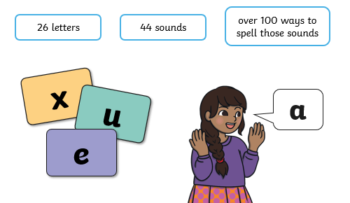
Phonics

Slide 6
Phonics
Systematic synthetic phonics – The teaching of reading and spelling by breaking down words into the smallest unit of sound.
Phoneme – Any of the 44 sounds which make up words in the English language.
Grapheme – How a phoneme is written down. There can be more than one way to spell a phoneme. For example the phoneme ‘ai’ is spelt differently in each of the words ‘way’, ‘make’, ‘fail’, ‘great’, ‘sleigh’ and ‘lady’.
Blending – Putting together the sounds in a word in order to read it, e.g. ‘s-u-n, sun’
Segmenting – Breaking/stretching a word into sounds in order to spell them, e.g. ‘sun, s-u-n’

Slide 7

Phonics
Essential letters and sounds
Daily sessions
Children are taught reading and spelling daily throughout the week and each session follows a structured format
Activities will vary & be adapted.
Regular assessments

Slide 8
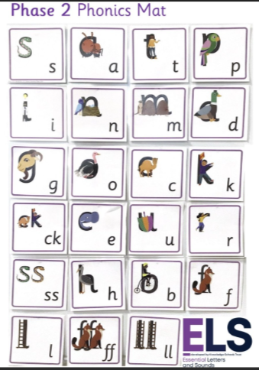
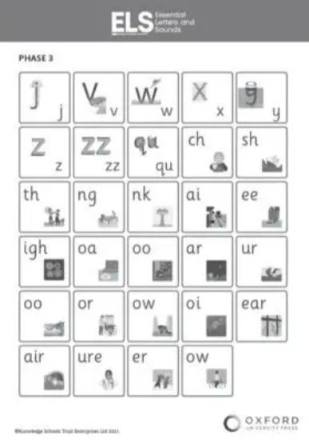
Phonics
Phase 1 – pre-schools; 7 aspects (including rhythm & rhyme, oral blending and segmenting, alliteration)
Phase 2 – mainly single sounds
Phase 3 – digraphs

Slide 9
Phonics
Phase 4 – initial and final blends ‘frog’
‘tent’
Phase 5 - new graphemes & alternative graphemes for the sounds they already know. The children will be automatically decoding a large number of words for reading by this point.
Phase 6 - children will be reading longer and less familiar texts independently and fluently. It is crucial that, at this point, children are now reading to learn and reading for pleasure.
Phonic screening check at the end of year 1.

Slide 10
Tapestry
Logins
Upload photographs of family

Slide 11
Assessment
Baseline assessments
Phonics assessments
End of year

Slide 12
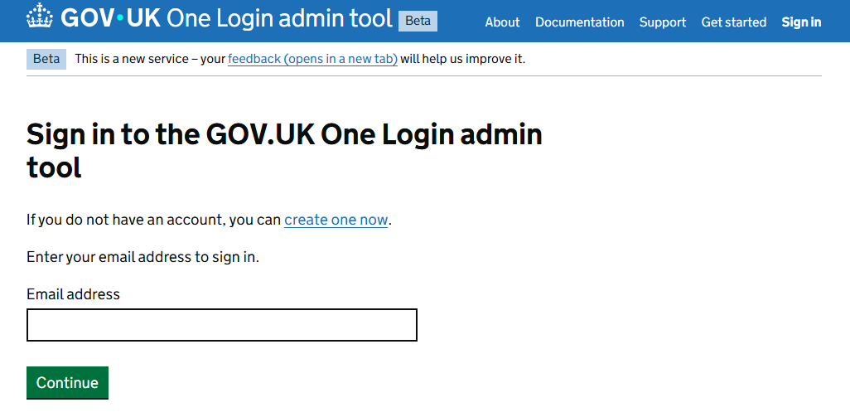
Housekeeping
Labelling clothes
Drinks
Opportunities to talk to teachers - after school
Let office know if child is absent
Pupil premium

Slide 13
P.E
Usually on Tuesday and Thursday
Hair/ear-rings
Shurdy Mile – everyday
Ensure PE kit is in school
Forest school – Summer term 2

