Slide 1
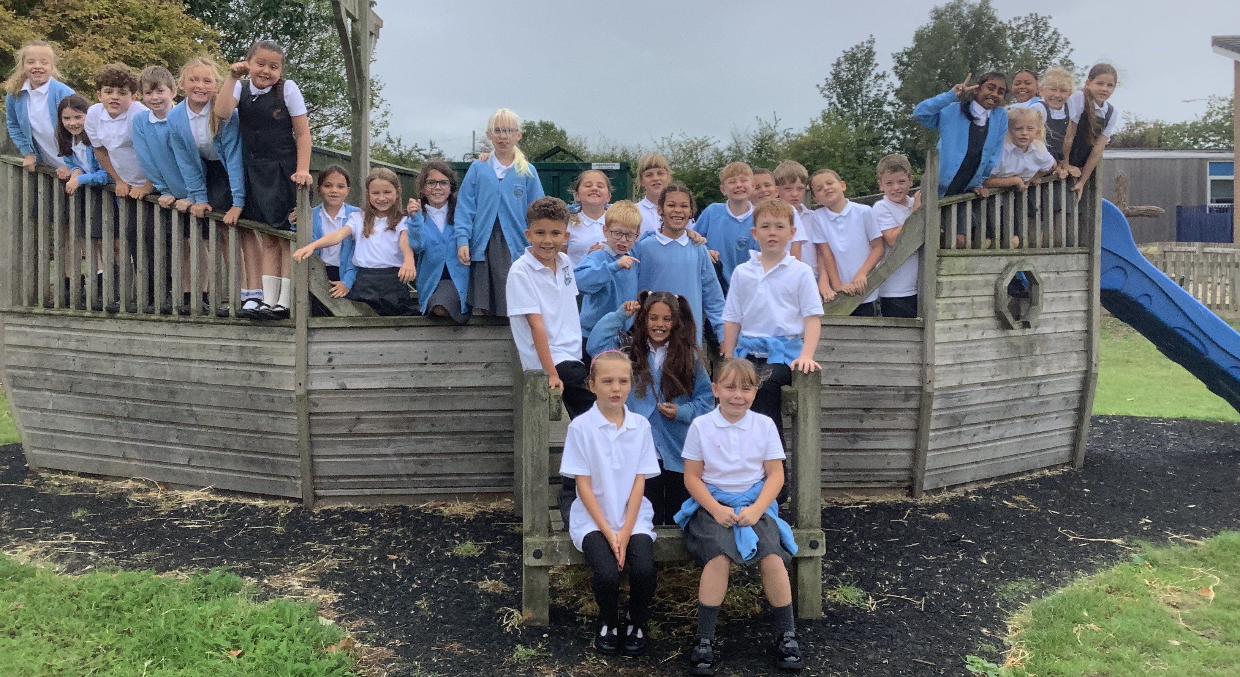
Welcome to Year 4!
Cherry Class
2025 - 2026

Slide 2
Adults in class
Monday – Mrs Dunn
Tuesday to Friday – Miss Cotter
Teaching Assistants – Miss Blake (full time) and Mrs Cooke (mornings only)

Slide 3
Curriculum Overview
History or Geography over the Year will be:
Autumn Term – The Romans in Britain (History)
Spring Term 1 – Europe with France as country study (Geography)
Spring Term 2 – Ancient Greece civilisations (History)
Summer Term – Rivers and Rainfall (Geography)
Daily Maths, English and Guided Reading
Spelling x3 sessions a week
Handwriting x 2 sessions a week
Weekly RE, Science, French, PE
Fortnightly Art, Computing, PSCHE, Music, P4C
Termly DT

Slide 4
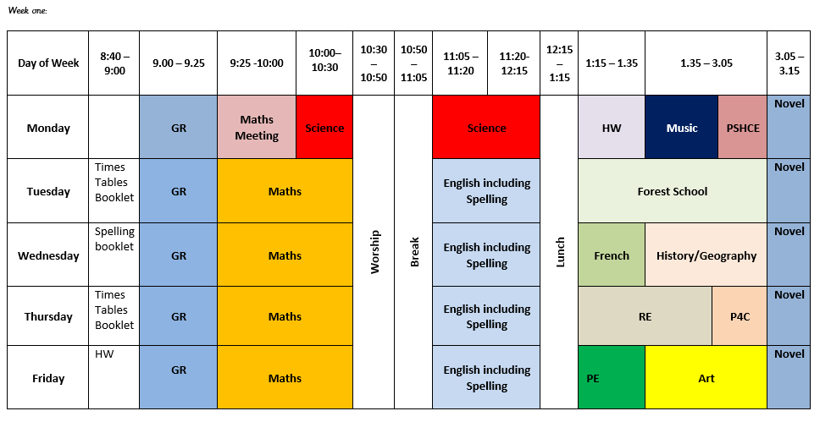
Two week timetable

Slide 5
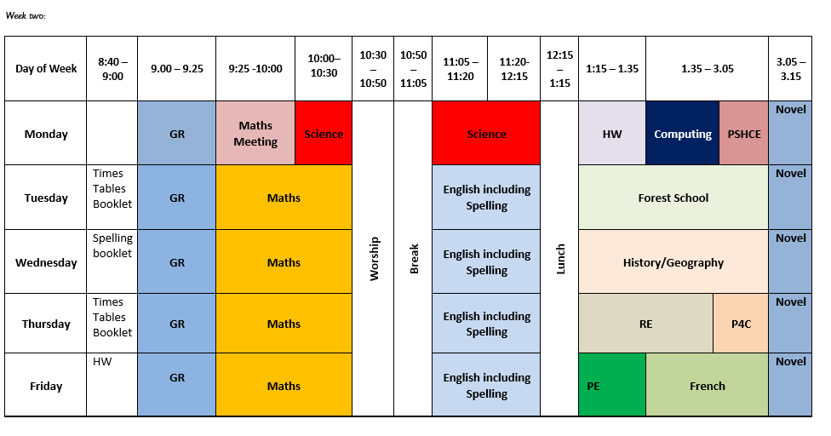
Two week timetable

Slide 6

Forest School
Autumn Term 1
Appropriate clothing
Tuesday afternoons

Slide 7





Class Novels

Slide 8




Guided Reading Texts

Slide 9
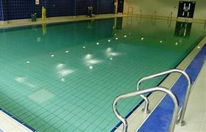
Swimming
Jan to April
Thursdays 11-11.30am
10 weeks
Goggles, towel, swimwear
Life saving week – pyjamas
Coach
3 groups
There will be a charge

Slide 10
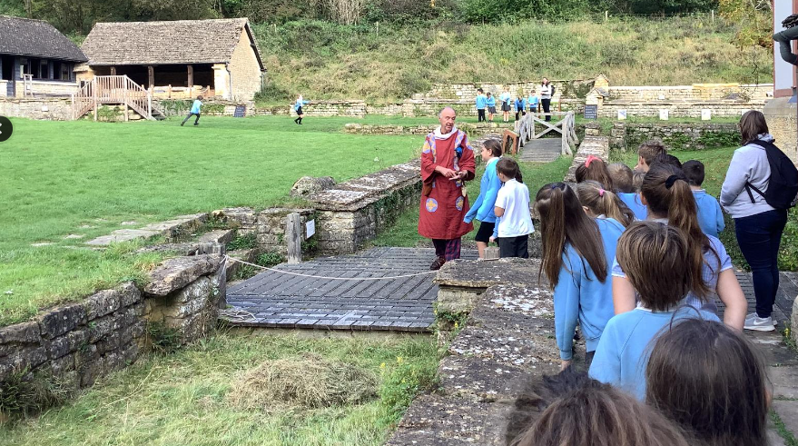
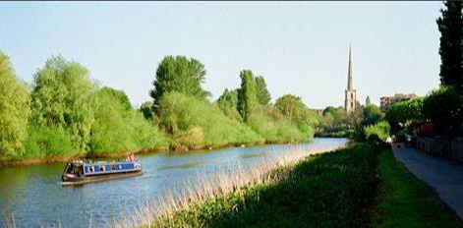
Trips
Autumn
Chedworth Roman Villa – Wednesday 8th October
Life Bus
Spring
To be confirmed!
In the Net
?
Summer
Canal and Riverside Worcester – Thursday 30th April
Cheltenham Performing Arts Festival
Science Festival
Severn Trent visit to school

Slide 11
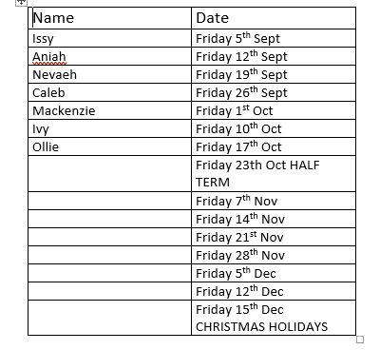
Stick Insects Weekend Rota!

Slide 12
Assessment
Multiplication Times tables check – June
Termly assessment for Maths, English and Reading which is assessed with formal assessments and teacher judgement
Reported to parents x3 a year in a report
Parents Evenings in October and February

Slide 13
Expectations
Homework – Friday to following Friday
Maths Activity, Spelling/Handwriting Activity. Found on the website or a physical sheet given.
Reading expectations! The more the better – everyday.
Behaviour will always be linked to our school rules.
Any issues come and see us. We have an open door policy.
Times tables are key in Year 4 – use TTR Logins so we can see progress

Slide 14
Other bits!
PE kit (Friday)
Label clothes
Drinks
Opportunities to talk to teachers
Let office know if child is absent
Commitment to clubs if sign up
End of day pick-ups – email to office
Wellies and waterproofs for OPAL Play

