Slide 1
PGL Year 6
September 2026

Slide 2
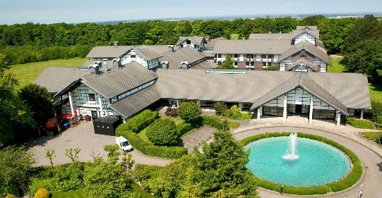
When:
Sunday 20th September – Wednesday 23rd September.
Leaving school at 2.40pm on the Sunday. Can you please be at the school for 2.15pm.
Back at school on Wednesday for the end of the school day.
Where:
Foxhill, Liddington, Swindon
(45 minute drive).

Slide 3
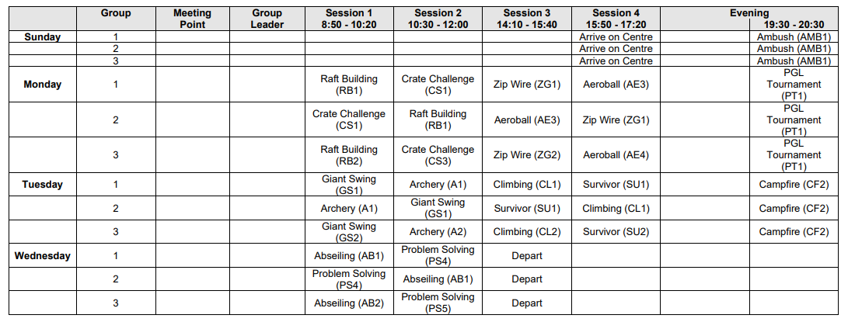
Provisional Activity Program

Slide 4
Adults currently attending
Mr Daniell
Mr Millin
Mrs Abraham & Mrs Townsend
Mrs Kempster – day time only

Slide 5
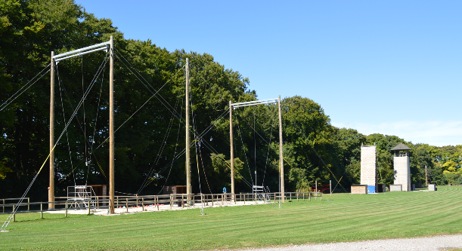
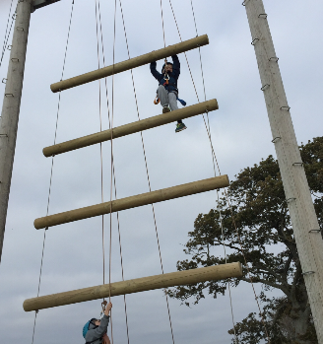

All fully trained instructors!!
We are their to support and encourage.
No child is forced to do any activity, but we would like them to have a go and strongly encourage them to do so!

Slide 6
Clothing children will need:
Various tops and jackets – t-shirts, long sleeved t-shirts, waterproof jackets, fleeces, jumpers. Need to have enough layers!
Trousers, jogging bottoms and legging – no jeans!
Nightwear, underwear and socks.
At least 2 pairs of trainers. Expect one pair to get ruined!
Weather – keep an eye on forecast
suncream, wooly hat and gloves.
More than you need – couple of spares
Please don’t go and buy anything new!

Slide 7
Other items!
2 towels – one for the shower and one during activities.
Drinks bottles.
Rucksack.
Couple of big bags for dirty/wet clothes.
Sleeping bag
Wash bag.
Torch
Warning – Children will have to carry all their luggage.
Some have struggled having lots of separate bags.
Might be good for children to have a list of what they’ve got. Some got confused as to what was theirs last year or what is was for.

Slide 8
Please do not bring!
Electrical devices such iPads, Switches etc.
Jewellery or anything of value – e.g. watches.
Aerosol sprays – they set the fire alarms off. Roll on please!
Mobile phones - if we need to we will contact you!
- Office contact information.
- Birthdays.
- If you have any issues, contact the school office.
Don’t worry about homesickness!

Slide 9
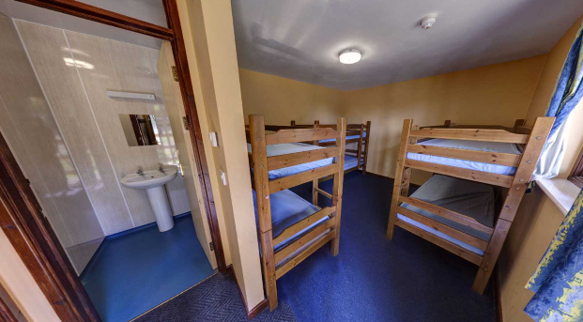
Rooms
Maximum of 4 in one room.
Bunk beds.
Separate toilet and shower area in each cabin.
May have other schools nearby but we will have our own section.
Ridgeway Building – nicer one!

Slide 10
Other bits
If your child requires medication.
Can you please let us know beforehand.
Can we be given this on the day in a named package with details.
In the new academic year, a form will be given out for you to complete.
Meals –
Three options for breakfast, lunch and dinner.
Access to teas, coffees and other drinks.
Access to salad bar and bread.
Can you please let us know beforehand of any dietary requirements.
Children can take up to £10 to spend at the tuck shop. Don’t over supply with sweets.
The shop accepts all types of bank card – GoHenry etc.
Parent mobile phone!

